Slide 1


Basic Details of the Team and Problem Statement
HackToFuture-2024
In Association with
The Institution of Engineers (India)
Local Centre, Belagavi
Domain :IoT
PS Code: IoT-03
Problem Statement Title:Develop an loT enabled Android application to give real time parking space available on the campus.
Team Name:Tech Clan
Team Leader Name:Keerti K M
Institute Name:KLS Gogte Institute of Technology, Belagavi

Slide 2
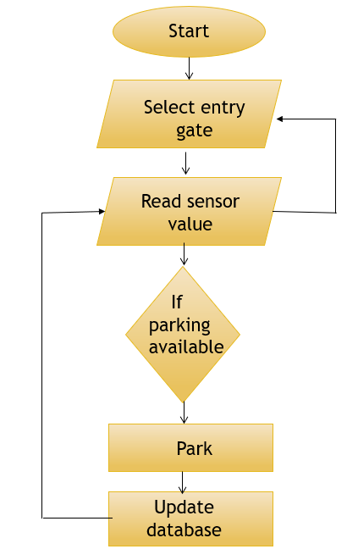
Idea/Approach Details
Flowchart:
Describe your idea/Solution/Prototype here:
Setup Hardware: Connect NodeMCU to ultrasonic sensors and install them in parking slots.
Create Firebase Project: Set up a real-time database and configure NodeMCU with Firebase URL and secret.
Database Structure: Design the database to store parking slot status with unique identifiers.
Develop Android App: Use MIT App Inventor to create an app that connects to Firebase and displays slot status in real time.
System Configuration: Ensure sensors, NodeMCU, Firebase updates, and app data display work correctly.
Deployment: Install hardware, launch the app, and provide user training and feedback collection.
Describe your Technology stack here:
Hardware Components
NodeMCU
Ultrasonic Sensors
Software Components
Google Firebase
MIT App Inventor
Arduino IDE

Slide 3
Idea/Approach Details
Describe your Use Cases here
Describe your Dependencies / Show stopper here
Real-Time Parking Availability: Check parking availability instantly via app.
Navigation to Available Parking: Get directions to nearest available parking spot.
Parking Slot Monitoring: Monitor occupancy and usage trends in real-time.
Integration with Campus Services:Seamlessly integrate with campus event and service platforms.
Network Connectivity:
Stable Wi-Fi connection for NodeMCU to communicate with Firebase.
Ensuring network coverage in parking areas for real-time updates.
Firebase Configuration:
Accurate setup of Firebase project with correct project URL and database secret.
Proper configuration of Firebase rules to ensure data security.
Android App Development:
Successful development and deployment of the Android app.
Compatibility with various Android devices and versions.
Data Accuracy and Reliability:
Accurate detection of vehicle presence by ultrasonic sensors.
Reliable transmission of parking slot status to the Firebase database.

Slide 4
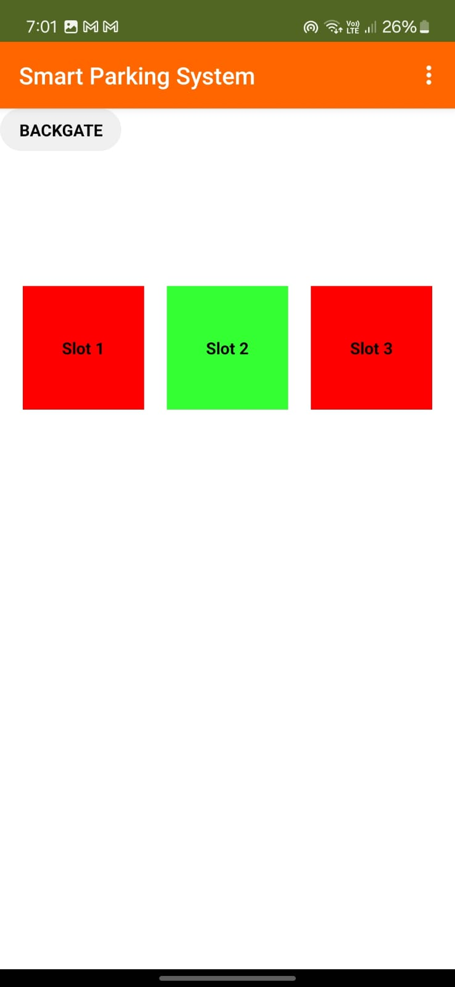
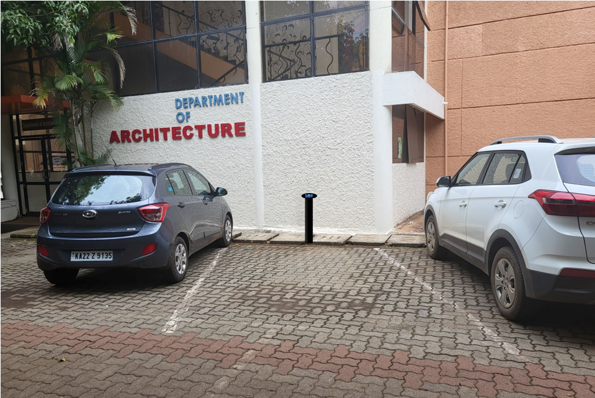
PROTOTYPE

Slide 5
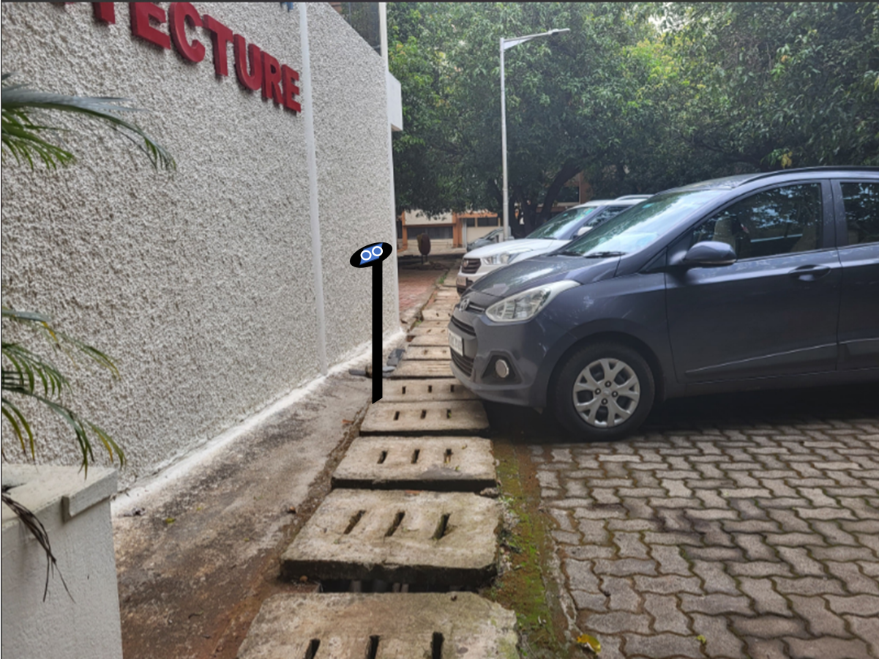
PROTOTYPE

Slide 6
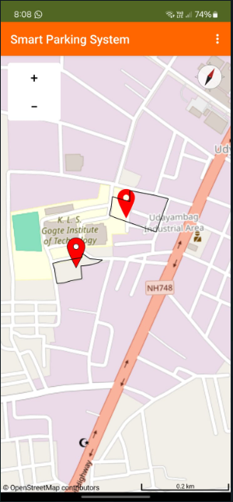
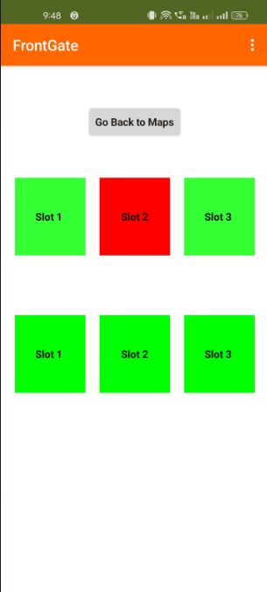
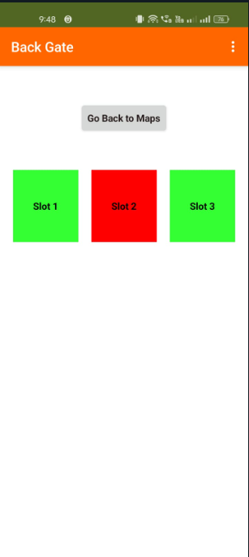
USER INTERFACE

Slide 7
Team Member Details
Team Leader Name: Keerti K M
Branch: BE, Stream:CSE, Year: III
Team Member 1 Name: Prasanna Nangnure
Branch: BE, Stream:CSE, Year: III
Team Member 2 Name: Vishwas Addanagi
Branch: BE, Stream:ECE, Year: III
Team Member 3 Name: Harish Marihalkar
Branch: BE, Stream:CSE, Year: III

